Slide 1

Attention Is All You Need
2022.01.12.
DongHyun KIM
gmr4rnjs@gmail.com

Slide 2

Contents
Introduction
Background
Model Architecture
Training & Result
Conclusion

Slide 3
Introduction
Recurrent models ( RNN, LSTM, etc.)
Recurrent neural networks have been firmly established as SOTA approaches in sequence modeling and transduction problems.
Because of Recurrent architechture, These models preclude parallelization within training examples (critical at longer sequence lengths, memory constraints limit).
Recent work has achieved significant improvements in comutational efficiency through factorization tricks, but the fundamental constraint is remain.
Attention mechanisms
It have become an integral part of compelling sequence modeling and transduction models in various tasks.
However, This attention mechanisms are used in conjunction with a recurrent network.

Slide 4
Introduction (Cont.)
Transformer
In this paper, The Transformer is proposed, a model architecture eschewing recurrence and instead relying entirely on an attention mechanism to global dependencies between input and output.

Slide 5
Background
Self-attention
The attention mechanism relating different positions of a single sequence in order to compute a representation of the sequence.
It has been used in reading comprehension, abstractive summarization, etc.
End-to-End memory networks
Based on a recurrent attention mechanism instead of sequence aligned recurrence.
It have been shown to perform well on simple-language question answering and language modeling tasks.

Slide 6
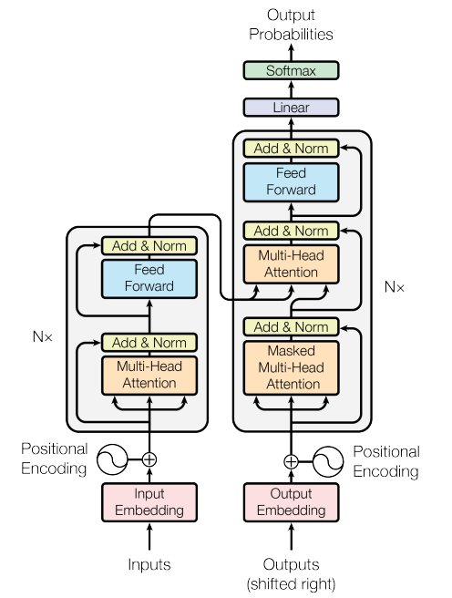
Model Architecture
Encoder-Decoder structure
Encoder
Composed of 6 identical layers, Each layer’s input is output of previous floor.
Each layer has two sub-layers.
Multi-head self-attention.
Position-wise fully connected feed-forward network
With sub-layers, a residual connection and layer normalization are employed.
Output of each sub-layers is LayerNorm(x+Sublayer(x)). Sublayer(x) is the function implemented by the sub-layer itself.
All sub-layers produce outputs of dimension d=512.

Slide 7
Model Architecture
Encoder-Decoder structure
Decoder
Composed of 6 identical layer.
Each layer has three sub-layers.
Multi-head self-attention.
Position-wise fully connected feed-forward network
Multi-head self-attention with output of encoder layer.
With sub-layers, a residual connection and layer normalization are employed.
With masking, the predictions for position i can depend only on the known outputs at positions less than i.

Slide 8
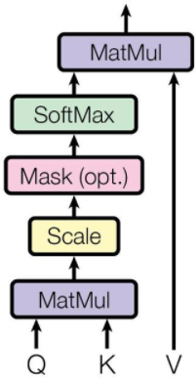

Model Architecture
Scaled Dot-Product Attention
Notes:
query Q와 key-value pair(K,V)받아서 output V에 가중치를 주는 방법. additive attention과 이론적 복잡도면에서는 거의 유사하지만, 꽤나 최적화가 잘 된 행렬 곱의 코드(요새 텐서플로우 같은 라이브러리 구현이 잘되어 있음)로 구현 가능하기 때문에 연산 속도와 공간 활용 면에서 훨씬 좋다.
그러나, 벡터의 차원이 커지면, 어텐션 메커니즘은 additive인 쪽이 scaling을 하지 않은 dot-product보다 성능이 훨씬 좋다는 단점이 있다.
“encoder-decoder attention”의 경우, Q : 디코더의 이전 레이어 hidden state K : 인코더의 output state V : 인코더의 output state “self-attention”의 경우, Q=K=V : 인코더의 output state

Slide 9
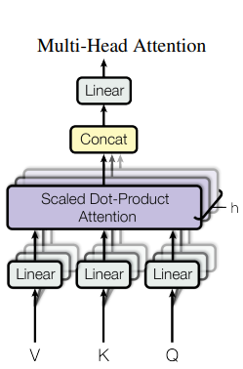

Model Architecture
Multi-Head Attention
Notes:
쿼리, 키, 밸류들을 각각 차원으로 번 선형 projection한 뒤 그 결과들을 모두 concat해서 사용하면 더 좋다는 사실이 발견되었다. 이러한 방식은 계산량이 많아질 것 같이 보이지만, projection으로 인한 차원 축소 때문에 계산량이 큰 폭으로 증가하지는 않는다고 한다. 출처: https://dalpo0814.tistory.com/49 [deeep]

Slide 10

Model Architecture
Positional Encoding
Transformer is not RNN or CNN, information about position of sequence.

Slide 11
Model Architecture
Demo

Slide 12
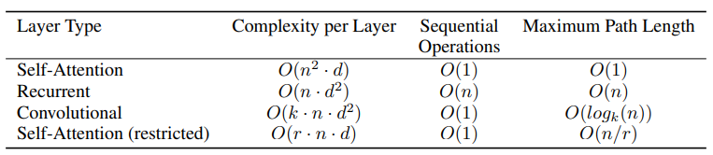
Why Self-Attention
Pros of Self-Attention
The total computational complexity per layer is decreased.
The amount of computation that can be parallelized is increased.
The path length between long-range dependencies in the network.

Slide 13
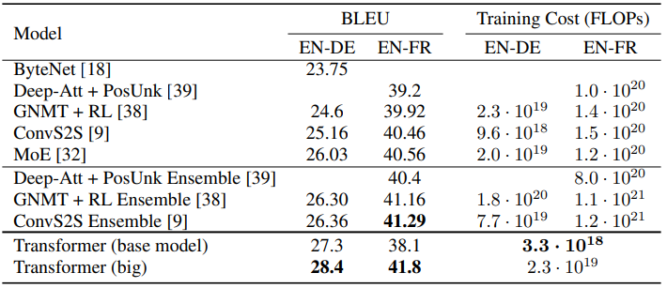
Training & Result
Training Data and Batching – WMT English-German dataset
Optimizer – Adam optimizer

Slide 14
Conclusion
For translation task, Transformer can be trained significantly faster than architectures base on rnn or cnn.
The Transformer can be extended to problems involving input and output modalities, etc.

Slide 15
Thank you for listening

